Slide 1

1
INTRODUCTION TO WEB DEVELOPMENT
Code: COMP07009
Week 12
Search Engines, SEO, Web Analytics

Slide 2
Search Engines
2
When you need to know about a particular topic on the web, how do you know which pages to read?
Visit a search engine (SE)
Special sites on the Web that are designed to help people find information stored on other sites
Eg Google, Yahoo and many more
SEs may have differences in the ways that they work

Slide 3
SE common basic tasks
3
Search the internet (or part of it) based on important words
Keep an index of the words they find, and where they find them
Allow users to look for words or combinations of words found in that index
In the past SE held an index of few hundred thousand pages
Today, a top SE will index hundreds of millions of pages

Slide 4
How do they work?
4
Before a SE can tell a user where a file is, it must be found
Special software robots, called spiders, are used to build lists of the words found on web sites
Process is called, Web crawling
Starting points are lists of heavily used servers and very popular pages
Begin with a popular site, indexing the words on its pages and follow every link found
Quickly spreads out across widely used parts of the Web

Slide 5
Search Engine
5
SEs (like Google) automatically add new web sites to their search index every time they crawl the Web
If a web site is new and unknown, it may take some time before it is found
Most SEs invite you to submit your site
Google: http://www.google.com/addurl.html
Yahoo: http://search.yahoo.com/info/submit.html
Bing:
http://www.bing.com/webmaster/SubmitSitePage.aspx
When you submit your site, you only need to specify
the top-level (home) page

Slide 6
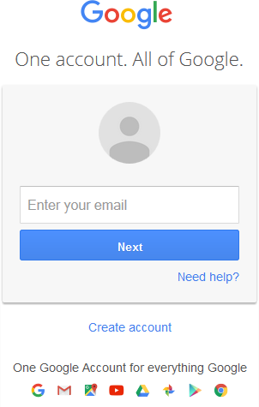
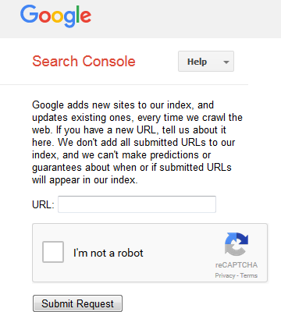
Google Example
6
http://www.google.com/addurl.html
You need to have an account before adding a url

Slide 7
Building a Search
7
Build a query and submit it through the SE
Can be simple, a single word
Can build an advanced query using Boolean operators
AND - All the terms joined by "AND" must appear in the pages
OR - At least one of the terms joined by "OR" must appear in the pages
NOT - The term or terms following "NOT" must not appear in the pages

Slide 8
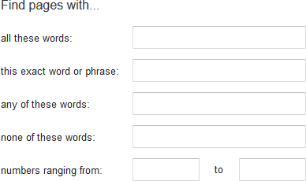
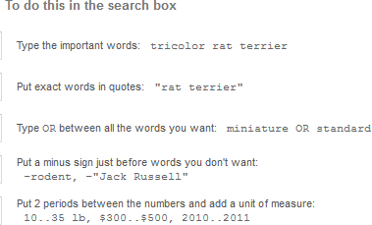
Google Example
8
https://www.google.com/advanced_search

Slide 9
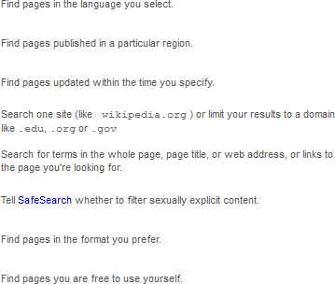
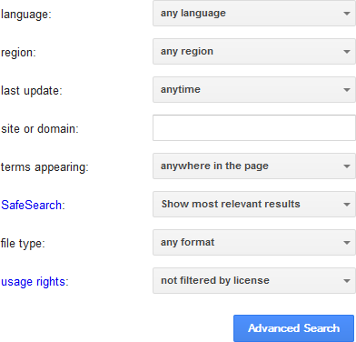
Google Example
9
Then narrow your results by:

Slide 10
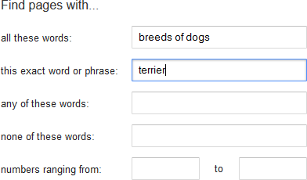
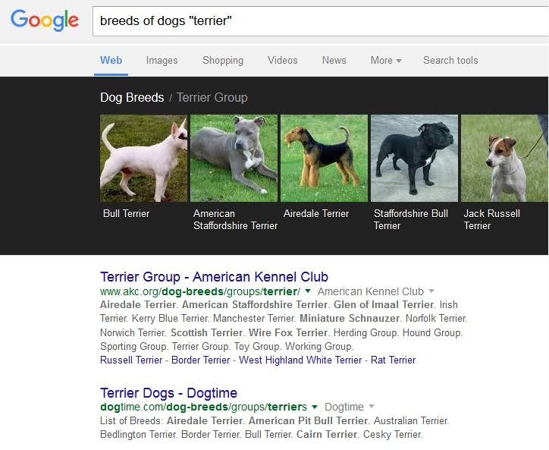
Google Example
10

Slide 11
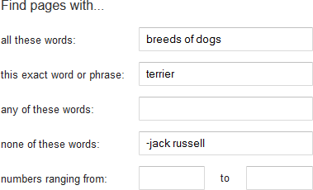
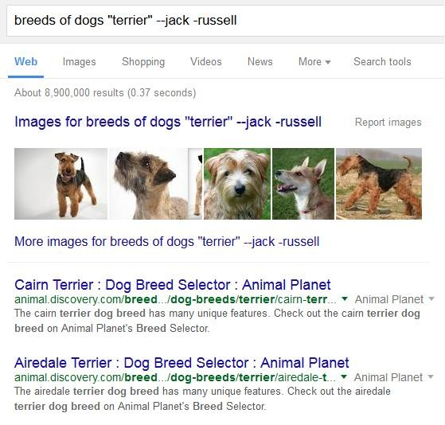
Google Example
11

Slide 12
HTML Meta Tags
12
Metadata is data about data
The <meta> tag provides metadata about the HTML document
Metadata will not be displayed on the page
Meta elements are used to specify key page description, keywords, author of the document and other metadata
<meta name=“description” content=“Olympic Games” />
Metadata can be used by browsers (how to display content or reload page), search engines (keywords), or other web services

Slide 13
HTML Meta Tags
13
Problem if tags added that fit popular topics but have nothing to do with page content
To protect against this, spiders will correlate meta tags with page content, rejecting the meta tags that don’t match the words on a page
Meta tags are placed inside the <head> element
Text in the tags are not displayed but tells the browsers (or other web services) specific information about the page
Many meta tags used in the past but not considered
useful now Eg keywords
Meta tags can be useful but doesn’t mean the web site will automatically be ranked at the top

Slide 14
Robots Meta Tag
14
It allows developer to specify that a particular page should not be indexed by a SE or if they do or do not want links on the page followed
Various implementations
<meta name="robots" content="noindex,nofollow" />
<meta name="robots" content="index,nofollow" />
<meta name="robots" content="noindex,follow" />
<meta name="robots" content="index, follow" />

Slide 15
Search Engine Optimisation
15
Improve the ranking of a web site in a search engine
The higher (or more frequently) a web site appears in search results list (like Google), the more visitors it is expected to receive
SEO considers how search engines work, what people search for, and which terms(words) are typed
Optimizing a website may involve editing the content (source code) to increase its relevance to specific keywords.

Slide 16
Search Engine Optimisation
16
Promoting a site to increase the number of links, is another SEO tactic
SEO tactics should be incorporated into the development, particularly into the menus and navigation structure
Another class of techniques, known as black hat SEO, uses methods such as link farms, keyword stuffing and article spinning that degrade both the relevance of search results and the quality of user-experience with search engines.
Search engines look for sites that employ these
techniques in order to remove them from their indices.

Slide 17
Black Hat SEO
17
Techniques used to get higher search rankings in an unethical manner
Break SE rules and regulations
Uses techniques such as keyword stuffing
Degrade the relevance of search results
Poor user experience
SEs look for sites that employ black hat techniques in order to remove them from their index

Slide 18
Web Analytics
18
WA is the measurement, collection, analysis and reporting of internet data for purposes of understanding and optimising web usage.
Much more than measuring web traffic.
Can be used as a tool for business and market research, and to assess and improve the effectiveness of a web site.
Can gauge traffic and popularity trends
http://en.wikipedia.org/wiki/Web_analytics

Slide 19
Web Analytics Tools
19
Every company, regardless of size, requires multiple tools to understand the performance of its website, happiness of its customers and gain key context from competitors.
According to Avinash Kaushik, author of Web Analytics
2.0 and Web Analytics: An Hour A Day, “the quest for a single tool/source to answer all your questions will ensure that your business will end up in a ditch, and additionally ensure that your career (from the Analyst to the web CMO) will be short-lived.” So in short, it’s of extreme importance to focus on multiplicity.

Slide 20
Web Analytics Tools
20
Examples
Clickstream Analysis Tools
Google Analytics (google.com/analytics)
Yahoo Web Analytics (web.analytics.yahoo.com)
Crazy Egg (crazyegg.com)
Social Analytics Tools
Twitalyzer (twitalyzer.com)
Competitive Intelligence Tools
Compete (compete.com)

Slide 21
Web Services
21
Urchin was a web statistics program developed by Urchin Software Corporation
Google acquired company in 2005
Measure Map was a blog stats service developed by Adaptive Path
Google acquired the product in 2006
Google rebranded as Google Analytics (GA)

Slide 22
Google Analytics
22
GA is one of the most widely used on-site web analytics service
GA is a service offered by Google that generates detailed statistics about the visits to a web site
Basic service is free and a premium version is available for a fee
Aimed at people in marketing rather than web developers
GA can track visitors, display advertising, pay-per-click (PPC) management

Slide 23
Google Analytics
23
Show high-level dashboard type data for the casual user
More in-depth data further into the report set
Identify poorly performing pages
Where visitors come from
How long they stayed
Their geographical location
Also, advanced features such as custom visitor segmentation

Slide 24
Google Analytics
24
GA e-commerce reporting can track sales activity and performance
Google Website Optimiser (GWO) tool enables testing different combinations of web content
June 2012, Google Website Optimiser tool was integrated as GA Contents Experiments

Slide 25
Adding GA to a web site
25
Go to GA web site http://www.google.com/analytics
Sign in or create a Google account
Create an account for GA
Get tracking code to paste into your web pages so Google knows when the pages have been visited (code available from GA web site)
Verify site ownership
Check tracking is installed and start using it

Slide 26
Useful web sites
26
http://www.w3schools.com
http://computer.howstuffworks.com
http://searchenginewatch.com/seo
http://www.google.co.uk/analytics/

Slide 27
Lab
27
Try different search engines to search for different topics of your choice
Try the advanced search methods to refine your search further
Submit one of your web pages to a search engine and interpret the results
Add meta tags to the page and submit again to see if the results are any different
Consider SEO for your web pages
Search for more information on Google Analytics

Slide 28
Finally ...
28
There are no other lectures/labs for this module so you should:
Complete any lab work
Continue to work on the second assessment which is worth 70% of
the overall module
Deadline for submission is 4pm on 27th December 2021
Hope you pass the module!!

Slide 29
Lab
29
There is not a new lab this week but check that you have completed all earlier labs.
Continue to work on Assessment 2
Remember and focus on the marking scheme
After you upload the assessment:
all links work;
all multimedia can be displayed properly.

